Slide 1
Basic concepts
Lecture 1a
Course leader: Oleg Sysoev

Slide 2
Course topics
Block 1
Basic concepts in machine learning. Software for ML. Classification and regression
Dimensionality reduction and model selection
Kernel methods (SVM) and neural networks
Block 2
Mixture models and ensemble methods

Slide 3
Course organization
1 topic= 3-4 lectures (Zoom) +1 lab (2h* 3, campus)+seminar (zoom)
Course given as
732A99 (9 ECTS): Block 1+Block 2
732A68 (9 ECTS): Block 1+Block 2
TDDE01 (6 ECTS): Block 1
Labs
Sign-up at LISAM, exactly 3 persons! (otherwise group can be split)
Take around 8h , group report
Recommended strategy: one person has main responsibility for one assignment in the lab.
Statement of Contribution: describe clearly how each member contributed to the group report (which member which assignment). Without it lab is automatically failed.
Deadlines
To pass exam, each individual needs to have experience of solving all lab tasks → make sure to try all tasks before the exam!
Published a couple of days in advance – try doing before attending to the first lab session!
Submission via LISAM

Slide 4
Course organization
Lectures
Available as PowerPoint or PDF, normally at LISAM
Write in the chat if you have questions during the lectures
Seminars
Obligatory attendance of all seminars
Zoom
Speaker and opponent groups
Discussion of the latest lab
Presentation schedule will be published on LISAM (Seminar.PDF)

Slide 5

Course organization
Examination
laboratory part + computer-based exam
Lecture 1b is ’Basic Statistics’
Lecture 1c is ’Introduction to R’
http://www.swagseduction.com/wp-content/uploads/2014/11/stressful.jpg

Slide 6
What is Machine Learning ?
Machine learning is a subfield of computer science that evolved from the study of pattern recognition and computational learning theory in artificial intelligence.
Machine learning explores the study and construction of algorithms that can learn from and make predictions on data. Such algorithms operate by building a model from example inputs in order to make data-driven predictions or decisions, rather than following strictly static program instructions.
Wikipedia (Oct 15, 2016).

Slide 7
Machine Learning and Statistics
ML=intersection of computer science, statistics and artificial intelligence.
Related: data mining, knowledge discovery and data science.
ML uses mainly statistical (probabilistic) models for analyzing data .
Data mining and knowledge discovery tend to use less rigorous, but often effective, algorithms.
ML is not a discovery of a hidden information (Data Mining)
ML vs Statistics: ML has a heavier focus on prediction , and lesser on interpretation.
ML applications often involve large sets →computational complexity of algorithms is important.
Statistics often does not care about runtime

Slide 8

Why probability models?
Probability models and statistical inference provide a framework
A principled way to think about any problem in machine learning
Probabilistic model →Estimation →Prediction
Probabilistic models quantify uncertainties.
Deterministic answers may often be inappropriate
http://lolnada.org/t/src/1454993210255.jpg
The currency exchange rate tomorrow will be 10.41!

Slide 9
Why probability models?
As robotics is now moving into the open world, the issue of uncertainty has become a major stumbling block for the design of capable robot systems. Managing uncertainty is possibly the most important step towards robust real-world robot systems.
from the book Probabilistic Robotics by Thrun et al.

Slide 10
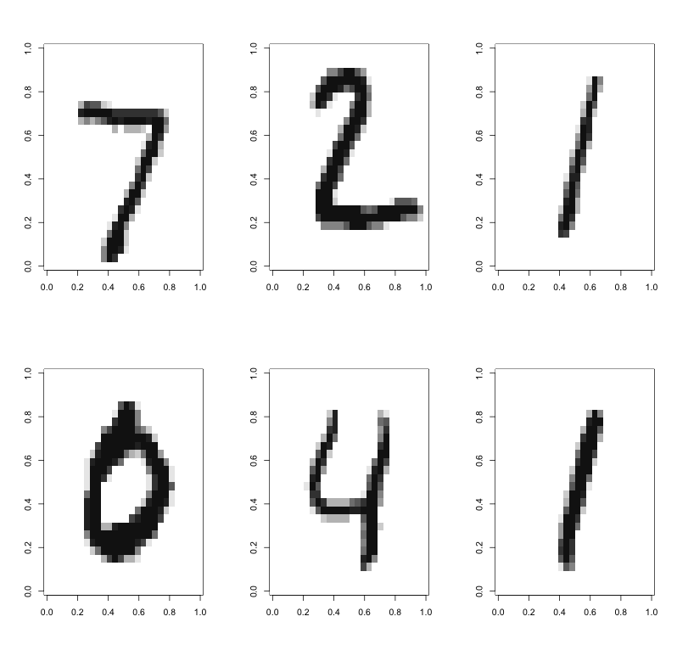
Example: classifying hadwritten digits

Slide 11
Example: classifying hadwritten digits
Training data: 60000 images.
Test data: 10000 images.
Features: intensities (0-255, scaled to 0-1) in the 28 × 28 = 784 pixels as features.
Methods:
Multinomial regression with LASSO prior
Support vector machines
Neural Networks (deep?)

Slide 12
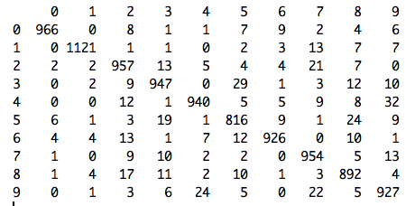
Example: classifying hadwritten digits
Confusion matrix
PREDICTION
TRUTH

Slide 13
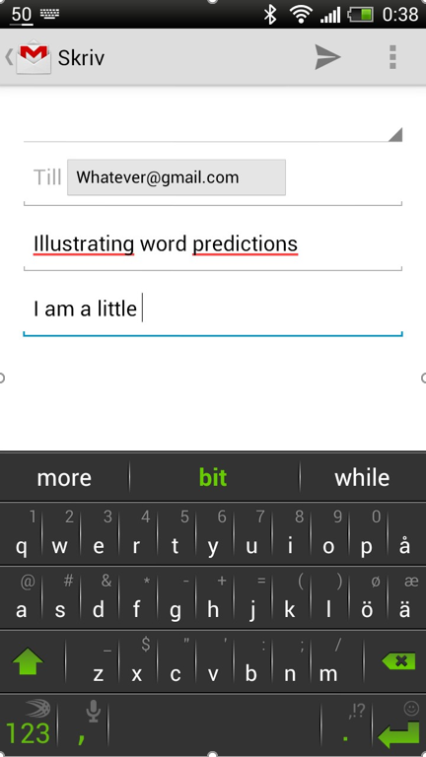
Example: smartfone typing predictions

Slide 14
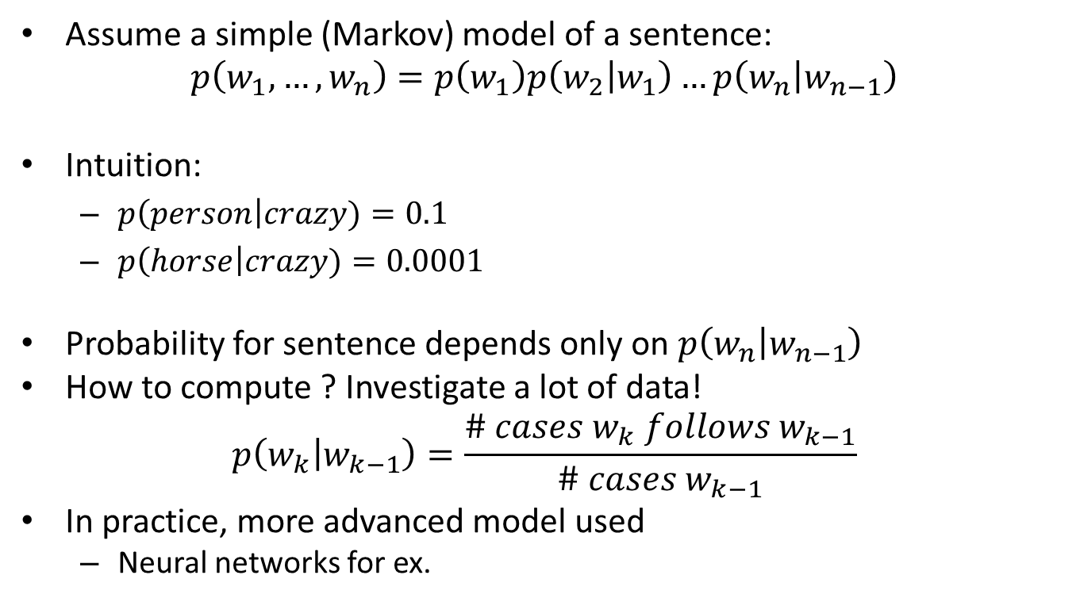
Example: smartfone typing predictions
Assume a simple (Markov) model of a sentence:
$$p\left(w_{1},…, w_{n}\right)=p\left(w_{1}\right)p\left(w_{2} | w_{1}\right)…p\left(w_{n} | w_{n−1}\right)$$
Intuition:
$p\left(person\right|crazy)=0.1$
$p\left(horse\right|crazy)=0.0001$
Probability for sentence depends only on $p\left(w_{n} | w_{n−1}\right)$
How to compute ? Investigate a lot of data!
$$p\left(w_{k} | w_{k−1}\right)=\frac{\# cases w_{k} follows w_{k−1}}{\# cases w_{k−1}}$$
In practice, more advanced model used
Neural networks for ex.
Highest P(?|Donald) ?

Slide 15
Types of learning
Supervised learning (classification, regression)
Compute parameters from data
Given features of a new object, predict target (generalize beyond seen training data)
Classification (Y=categorical), Regression (Y=continuous)
Most of ML models: Neural Nets, Decision Trees, Support Vector Machines, Bayesian nets
x*,?
Datase =t
{Xi, Yi}
Model(?,?,?,...)
Model(a,b,c,...)
x*,y*

Slide 16
Types of learning
Unsupervised learning (→Data Mining)
No target
Aim is to extract interesting information about
Relations of parameters to each other
Grouping of objects
Ex: clustering, density estimation, association analysis
x1<-> x2<-> x3...

Slide 17
Types of learning
Semi-supervised: targets are known only for some observations.
Active learning. Strategies for deciding which observations to label
Reinforcement learning. Find suitable actions to maximize the reward. True targets are discovered by trial and error.
Transfer learning: use knowledge from some domain to train better models in a similar domain

Slide 18
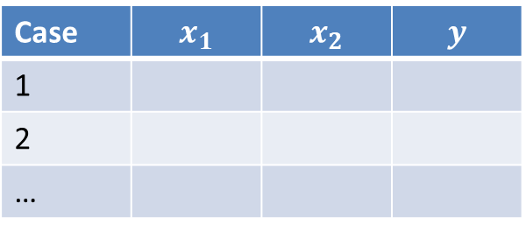
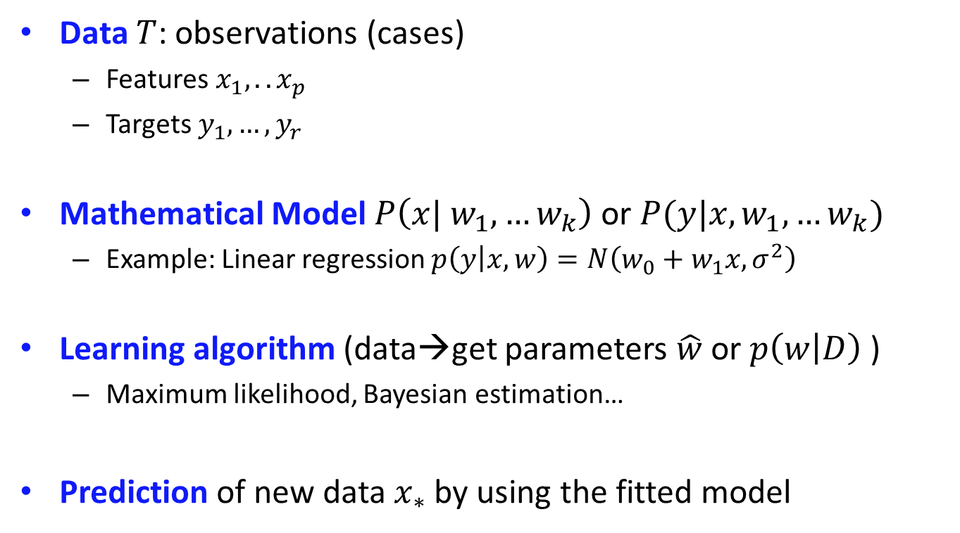
Basic ML ingridients
Data $Τ$: observations (cases)
Features $x_{1},.. x_{p}$
Targets $y_{1},…{,y}_{r}$
Mathematical Model $P\left(x| w_{1},…w_{k}\right)$ or $P(y|x,w_{1},…w_{k})$
Example: Linear regression $p\left(y | x,w\right)=N\left(w_{0}+w_{1}x, σ^{2}\right)$
Learning algorithm (data→get parameters $\hat{w}$ or $p\left(w | D\right)$ )
Maximum likelihood, Bayesian estimation…
Prediction of new data $x_{∗}$ by using the fitted model
Case | $$x_{1}$$ | $$x_{2}$$ | $$y$$
1
2
…

Slide 19
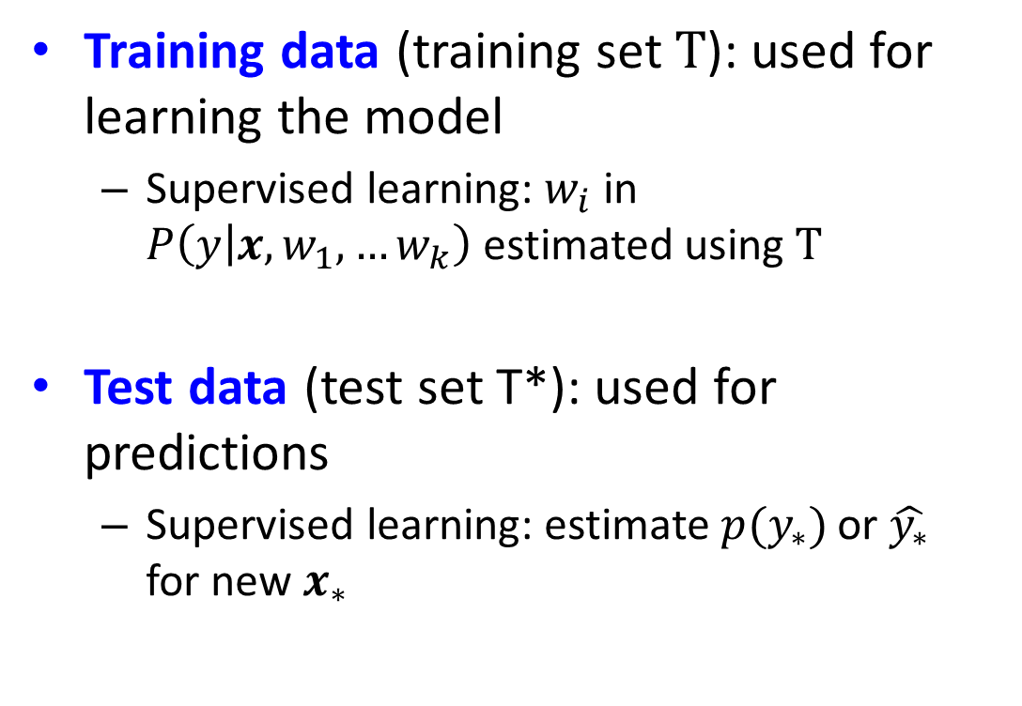
Types of data sets
Training data (training set$Τ$): used for learning the model
Supervised learning: $w_{i}$ in $P\left(y | x,w_{1},…w_{k}\right)$ estimated using $Τ$
Test data (test set T*): used for predictions
Supervised learning: estimate $p(y_{∗})$ or $\hat{y_{∗}}$ for new $x_{∗}$
X | Y
1.1 | M
2.3 | F
X | Y
1.3 | ?
2.9 | ?

Slide 20
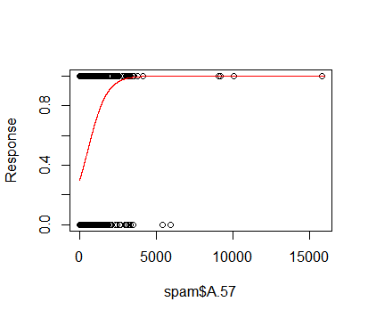
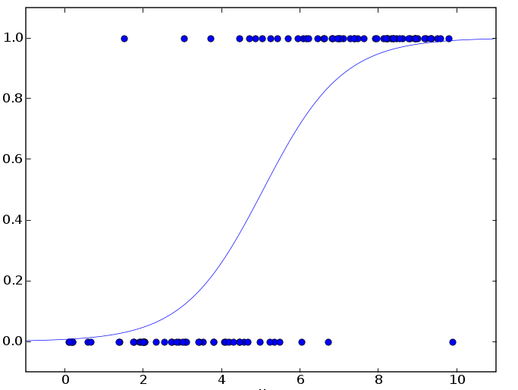

Logistic regression
Data $y_{i}∈\left\{Spam, Not Spam\right\}, x_{i}=\#of a word$
Model: $p\left(y=Spam | w,x\right)=\frac{1}{1+e^{−w_{0}−w_{1}x}}$
Learning algorithm: maximum likelihood
Prediction : $p\left(spam\right)=p\left(Y=spam|x_{∗}\right)$
We can also make point predictions -how?

Slide 21
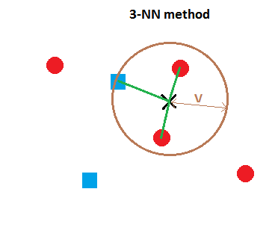
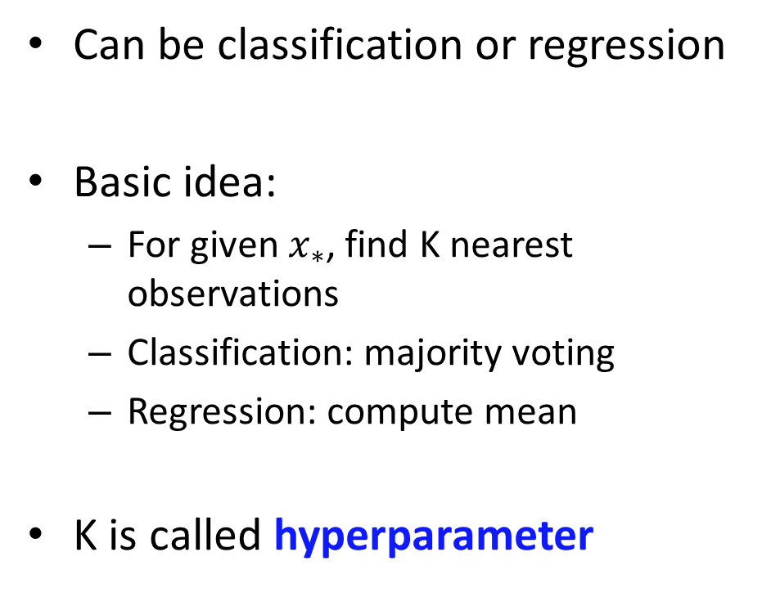

K-nearest neighbor model
Can be classification or regression
Basic idea:
For given $x_{∗}$, find K nearest observations
Classification: majority voting
Regression: compute mean
K is called hyperparameter
$$N_{∗}$$

Slide 22
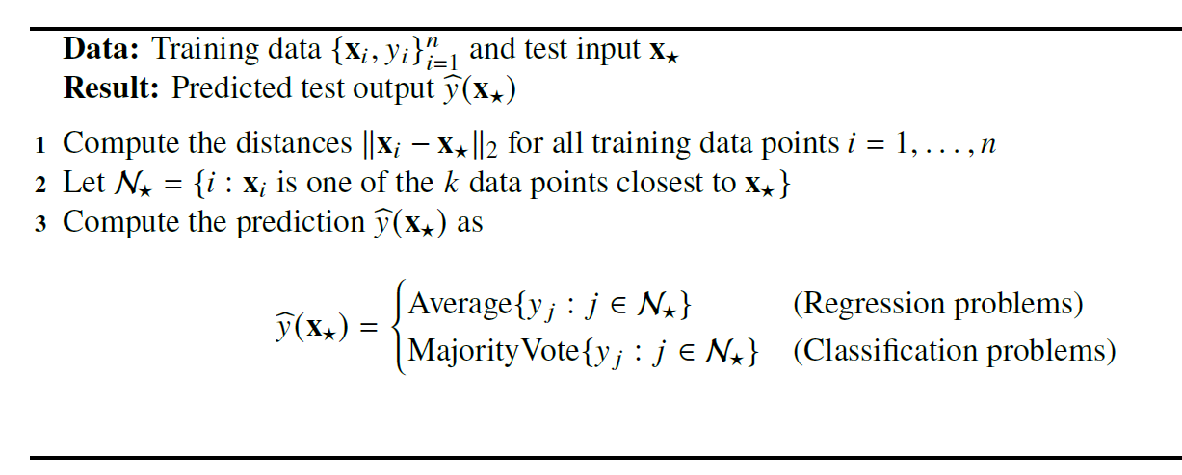
K-nearest neighbor algorithm

Slide 23
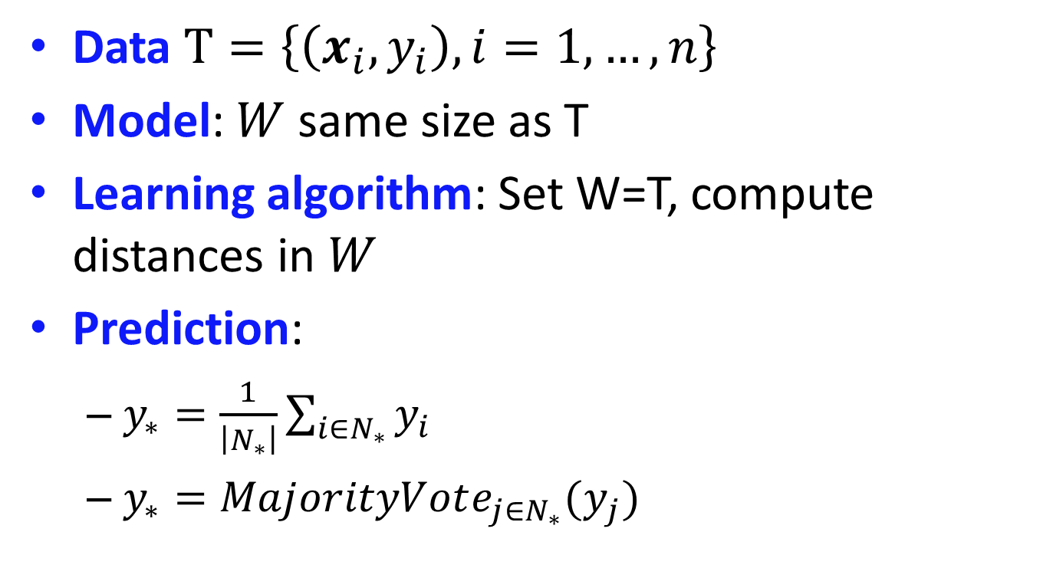
K-nearest neighbor model
Data $Τ=\left\{\left(x_{i}, y_{i}\right), i=1,…,n\right\}$
Model: $W$ same size as T
Learning algorithm: Set W=T, compute distances in $W$
Prediction:
$y_{∗}=\frac{1}{\left|N_{∗}\right|}\sum_{i∈N_{∗}}{y_{i}}$
$y_{∗}=MajorityVote_{j∈N_{∗}}(y_{j})$

Slide 24
K-nearest neigbor example
Classification
Music data, x1=song length, x2=a signal processing characteristic

Slide 25
K-nearest neighbor example
Regression
Car data: x1 speed when brake signal given, x2 distance until full stop
How to choose K?
How to define distance?

Slide 26
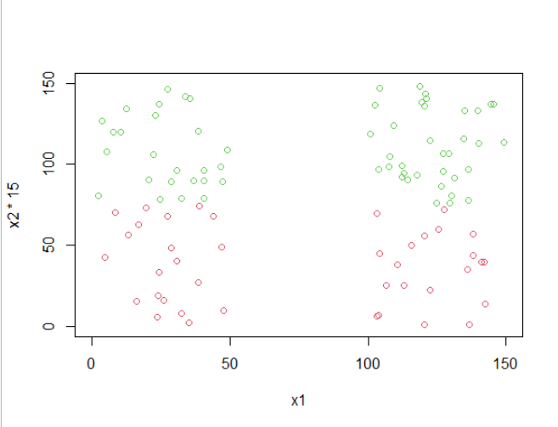
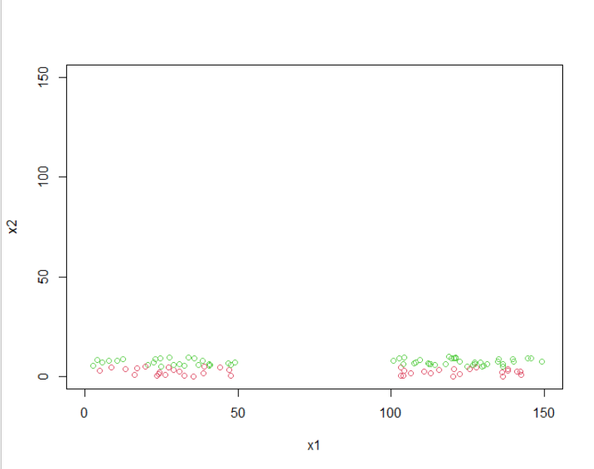

K-nearest neighbor model
Feature preprocessing: scaling
Important, for ex when defining distance
Usual preprocessing: $x_{ij}^{′}=\frac{x_{ij}−mean\left(x_{ij}| i=1,…n\right)}{std\left(x_{ij}|i=1,…n\right)}$
X
X

Slide 27
Overfitting
Which model feels appropriate?
Easy model, few parameters
Complex model,
many parameters

Slide 28
Overfitting
Now new data from the same process
Best prediction!

Slide 29
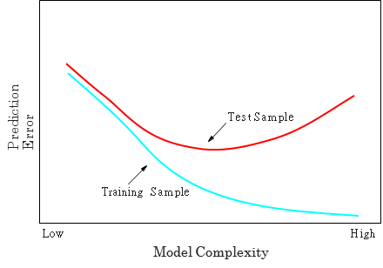
Overfitting
Observed:

Slide 30
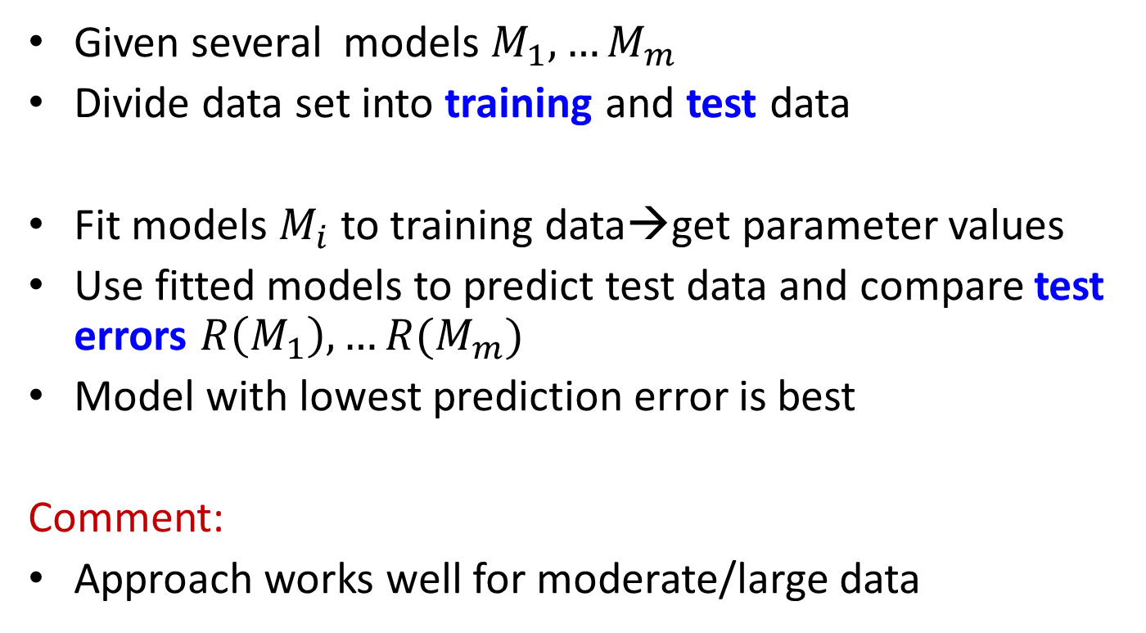
Model selection
Given several models $M_{1},…M_{m}$
Divide data set into training and test data
Fit models $M_{i}$ to training data→get parameter values
Use fitted models to predict test data and compare test errors $R\left(M_{1}\right),…R(M_{m})$
Model with lowest prediction error is best
Comment:
Approach works well for moderate/large data
Training
Test

Slide 31
Holdout method
Divide into training, validation and test sets
Choose proportions in some way
Test set is used to test a performance on a new data
Training
Validation
Test

Slide 32
Holdout in R
How to partition into train/test?
Use set.seed(12345) in the labs to get identical results
How to partition into train/valid/test?
n=dim(data)[1]
set.seed(12345)
id=sample(1:n, floor(n*0.7))
train=data[id,]
test=data[-id,]
n=dim(data)[1]
set.seed(12345)
id=sample(1:n, floor(n*0.4))
train=data[id,]
id1=setdiff(1:n, id)
set.seed(12345)
id2=sample(id1, floor(n*0.3))
valid=data[id2,]
id3=setdiff(id1,id2)
test=data[id3,]

Slide 33
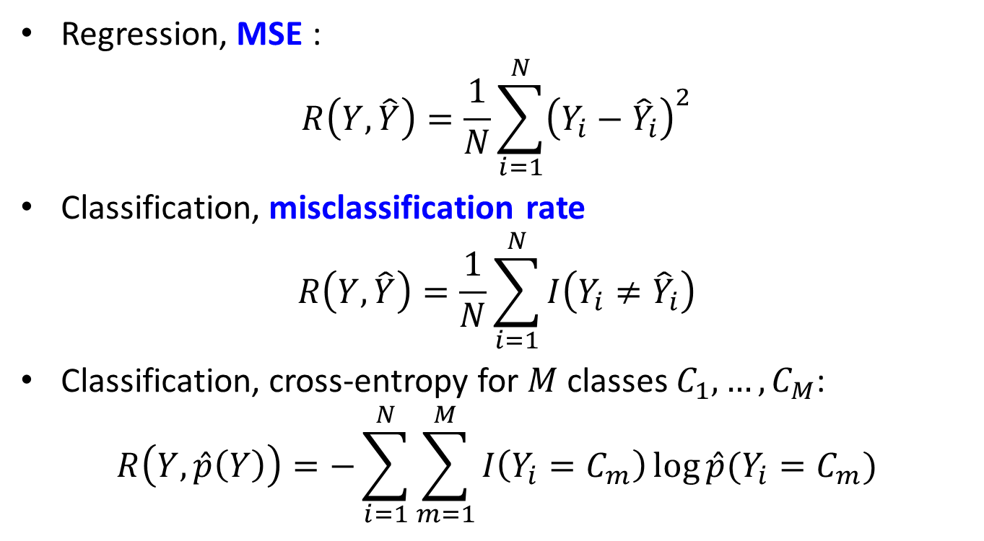
Typical error functions
Regression, MSE :
$$R\left(Y, \hat{Y}\right)=\frac{1}{N}\sum_{i=1}^{N}{{\left(Y_{i}−{\hat{Y}}_{i}\right)}^{2}}$$
Classification, misclassification rate
$$R\left(Y, \hat{Y}\right)=\frac{1}{N}\sum_{i=1}^{N}{I\left(Y_{i}≠{\hat{Y}}_{i}\right)}$$
Classification, cross-entropy for $M$ classes $C_{1},…, C_{M}$:
$$R\left(Y, \hat{p}\left(Y\right)\right)=−\sum_{i=1}^{N}{\sum_{m=1}^{M}{I\left(Y_{i}=C_{m}\right)\log{\hat{p}(Y_{i}=C_{m})}}}$$

Slide 34
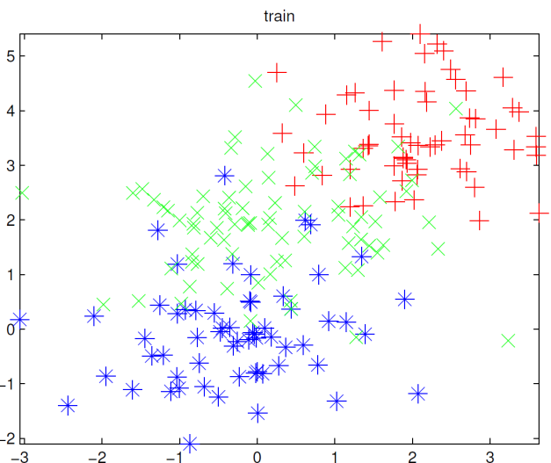
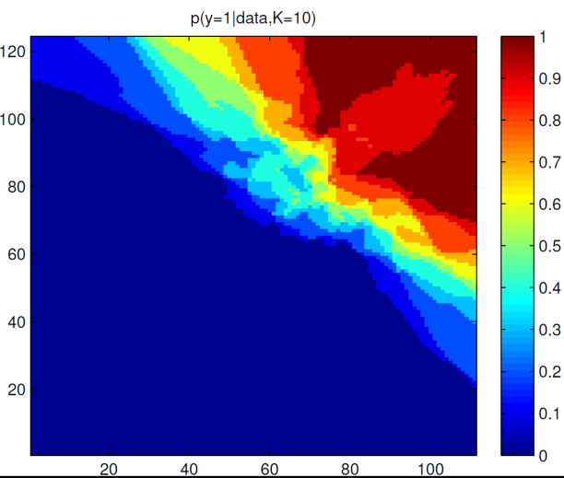
Model types
Parametric models
Have certain number of parameters independently of the size of training data
Assumption about of the data distribution
Ex: logistic regression
Nonparametric models
Number of parameters (complexity) changes with training data
Example: K-NN classifier

Slide 35
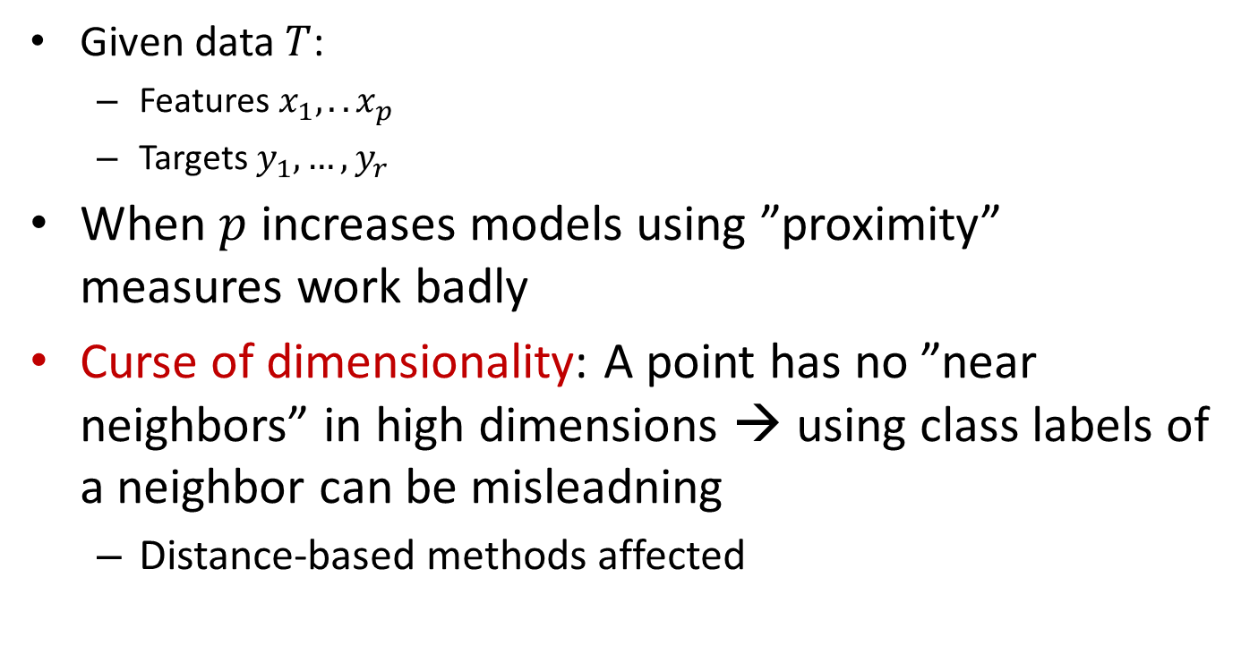
Curse of dimensionality
Given data $T$:
Features $x_{1},.. x_{p}$
Targets $y_{1},…{,y}_{r}$
When $p$ increases models using ”proximity” measures work badly
Curse of dimensionality: A point has no ”near neighbors” in high dimensions → using class labels of a neighbor can be misleadning
Distance-based methods affected

Slide 36
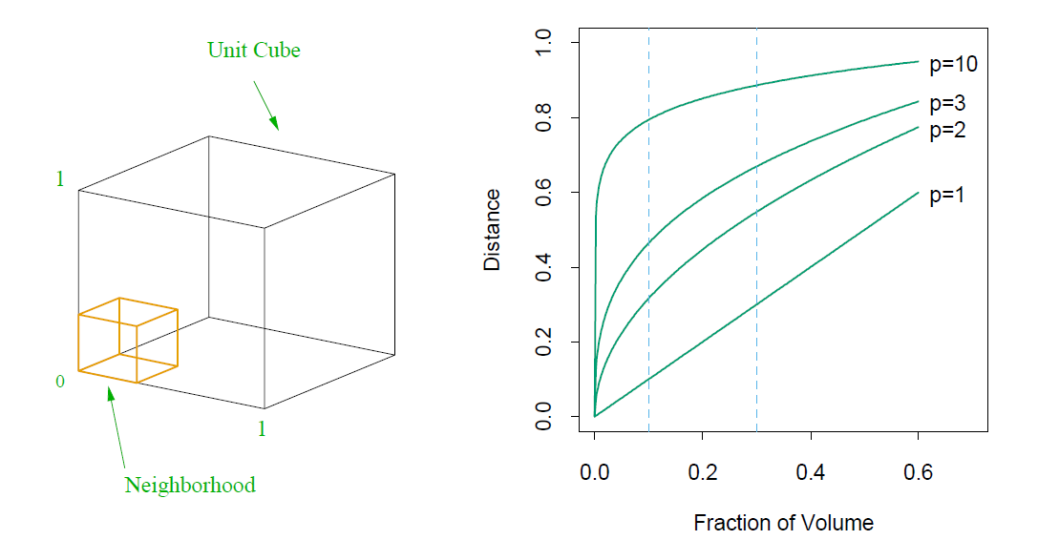
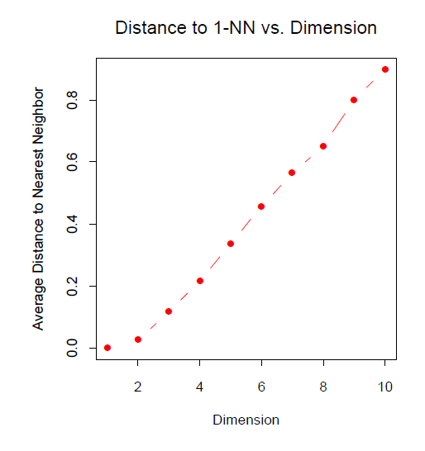
Curse of dimensionality

Slide 37
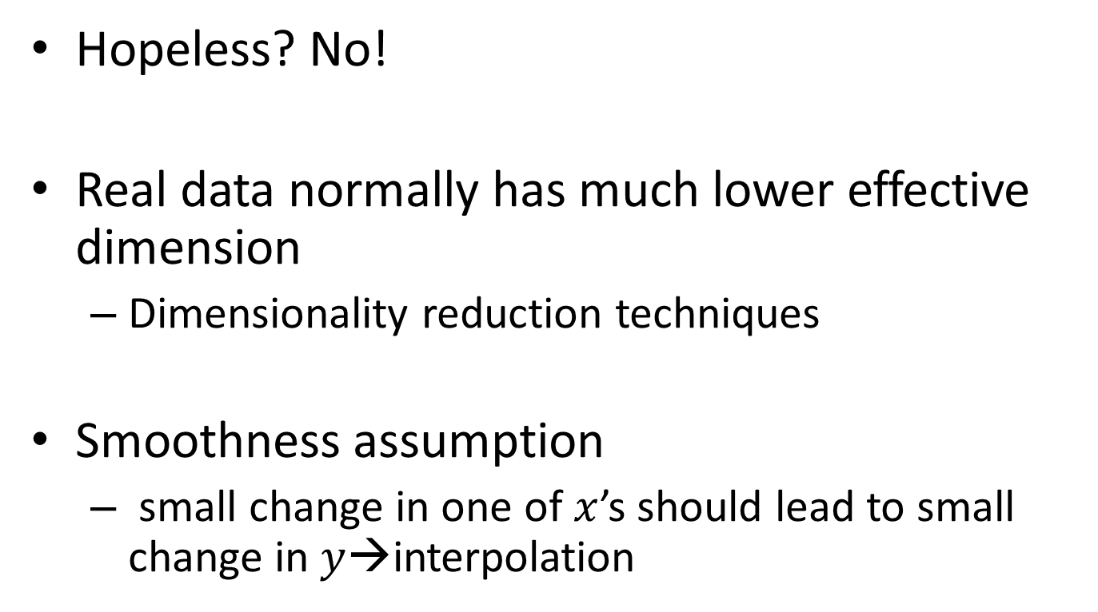
Curse of dimensionality
Hopeless? No!
Real data normally has much lower effective dimension
Dimensionality reduction techniques
Smoothness assumption
small change in one of$x$’s should lead to small change in $y$→interpolation

